Slide 1


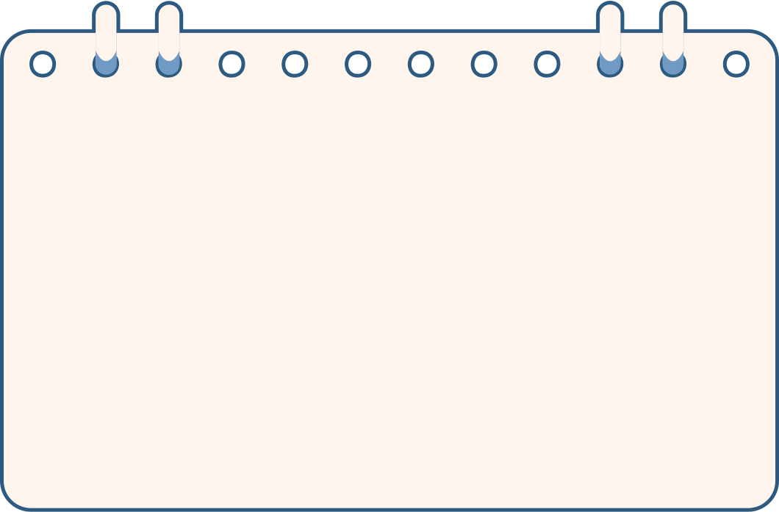
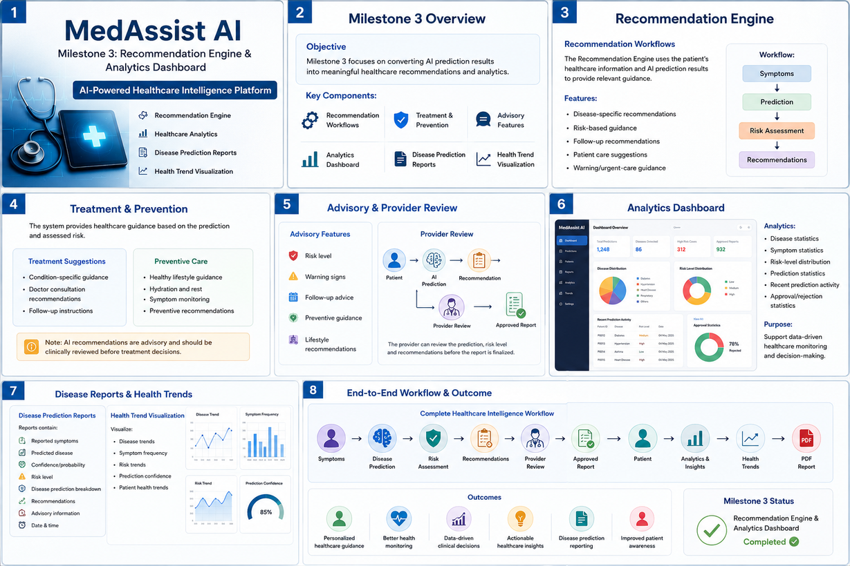

MILESTONE 3: RECOMMENDATION ENGINE & ANALYTICS DASHBOARD

Slide 2
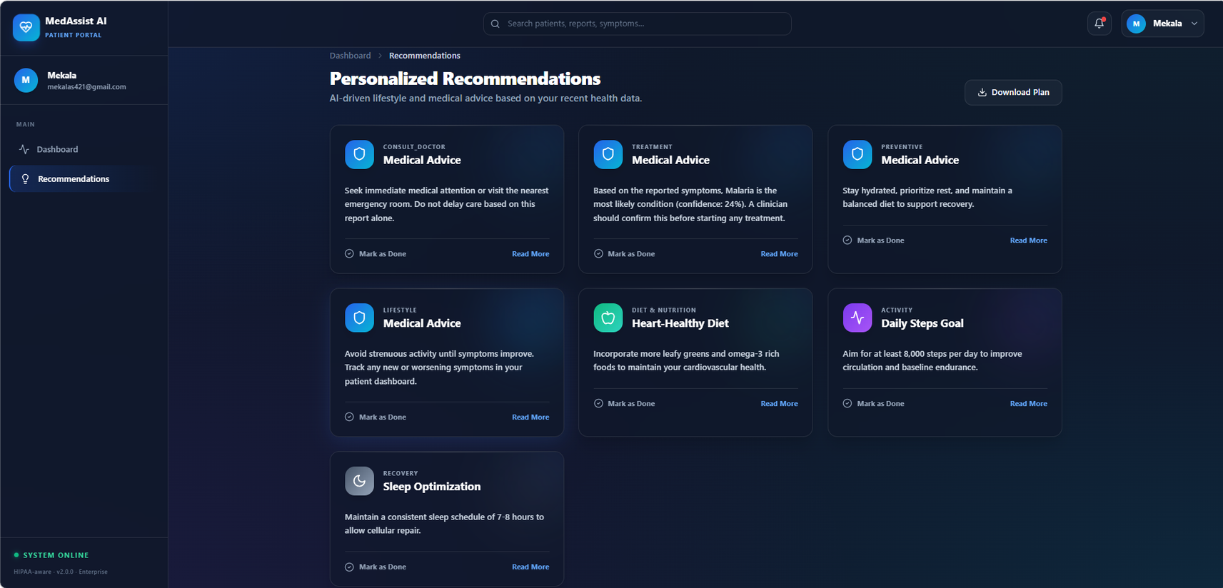

RECOMMENDATION ENGINE

Slide 3


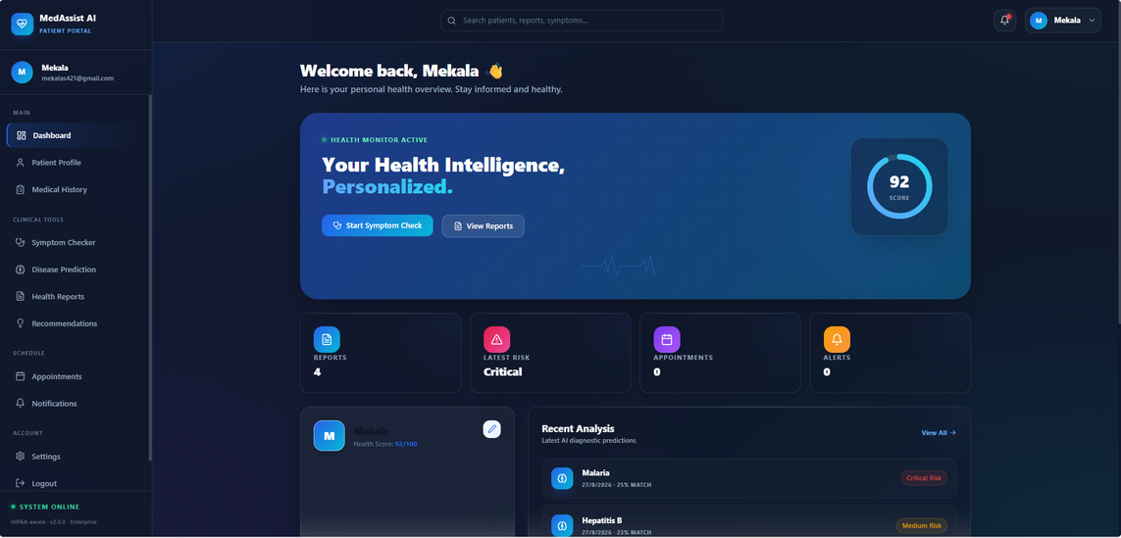

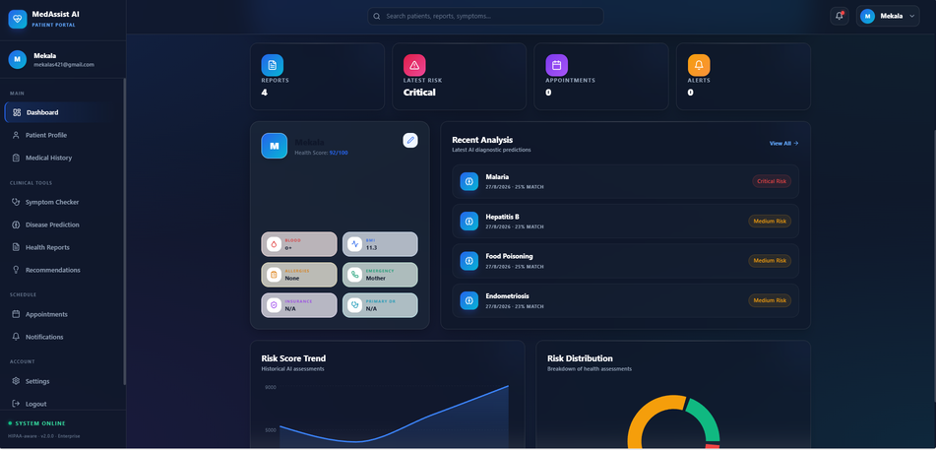



Slide 4

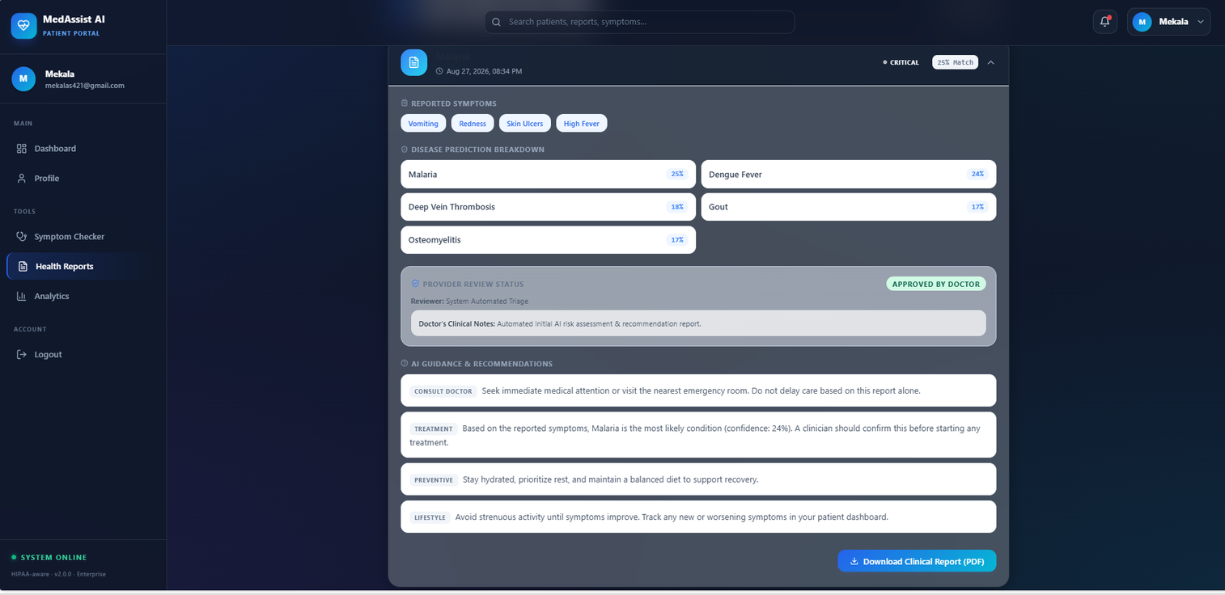

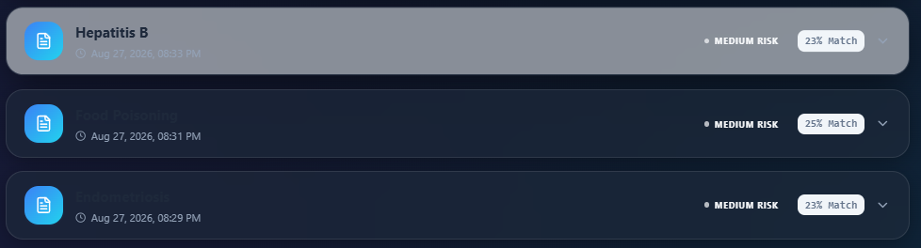

Slide 5
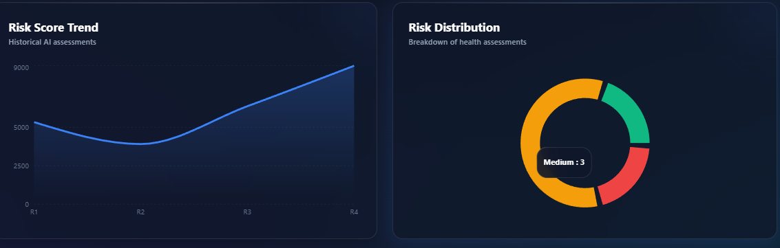
ANALYTICS DASHBOARD
Healthcare Analytics Dashboard
The dashboard converts existing healthcare data into useful insights.
Analytics:
Disease statistics
Symptom statistics
Risk-level distribution
Prediction statistics
Recent prediction activity
Approval/rejection statistics
Purpose:
Support data-driven healthcare monitoring and decision-making.

Slide 6
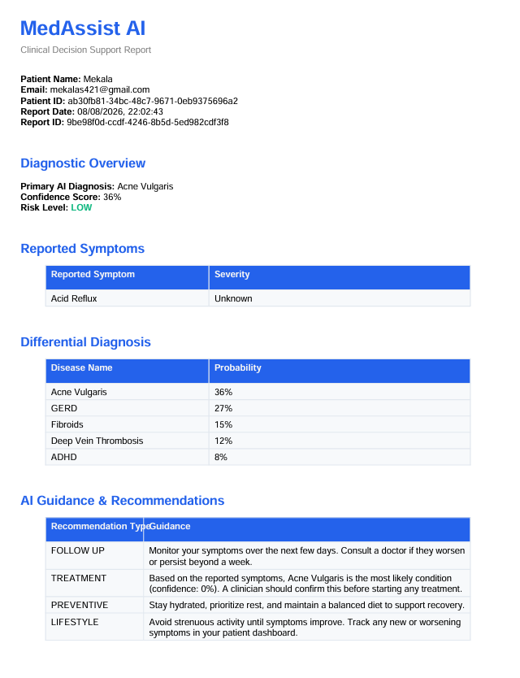


DISEASE REPORTS & HEALTH TRENDS
Disease Prediction Reports
Reports contain:
Reported symptoms
Predicted disease
Confidence/probability
Risk level
Disease prediction breakdown
Recommendations
Advisory information
Date & time
Health Trend Visualisation
Visualize:
Disease trends
Symptom frequency
Risk trends
Prediction confidence
Patient health trends

